Slide 1

EJ Ride
The best application to go any place

Slide 2
Team members
01
02
03
04
05
06
Farha
Habiba
Gana
Nehad
Thamer
Hashem
07
08
Laith
Mohammad

Slide 3

01
Farha

Slide 4
Introduction
Our dataset includes detailed information on individual trips made by a ride-sharing or taxi service. Each row represents a unique trip and includes identifiers for the user and driver, the condition of the car, weather and traffic conditions, temporal information (hour, day, month, weekday, year), and spatial information (pickup and dropoff coordinates). Additionally, it contains details about the fare, distance, and passenger count.
This comprehensive dataset can be used for various analyses, such as:
Fare Analysis: Understanding fare trends based on time, weather, traffic, and distance.
Driver Performance: Evaluating drivers based on the number of trips and fare amounts.
User Behavior: Analyzing user preferences and frequent travel times.
Spatial Analysis: Investigating popular pickup and dropoff locations and distances to key landmarks or airports.

Slide 5
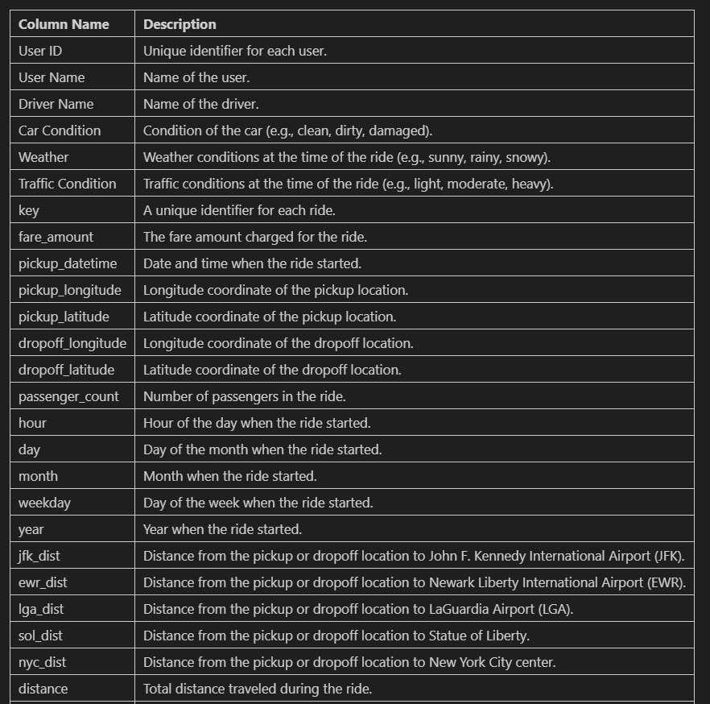

About Dataset

Slide 6
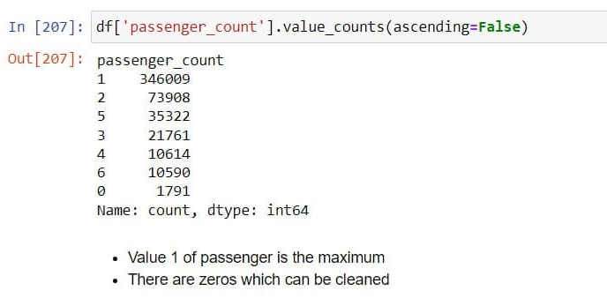
Passenger Count

Slide 7
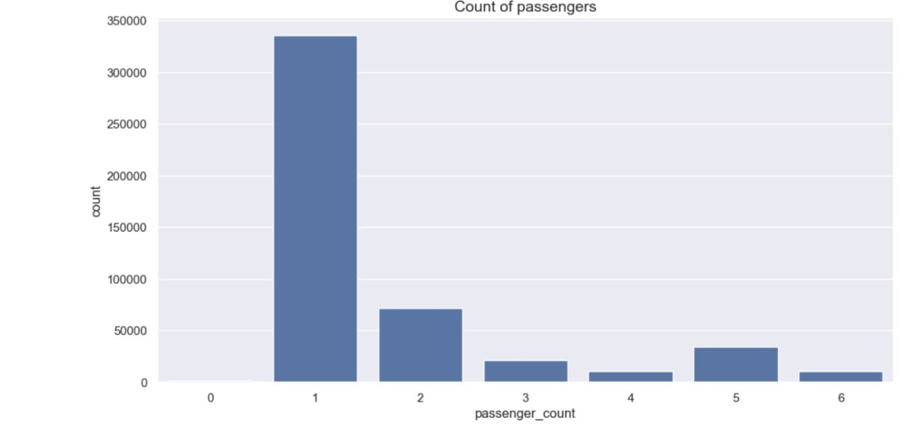
Bar-plot for Passenger Count

Slide 8
02
Habiba

Slide 9
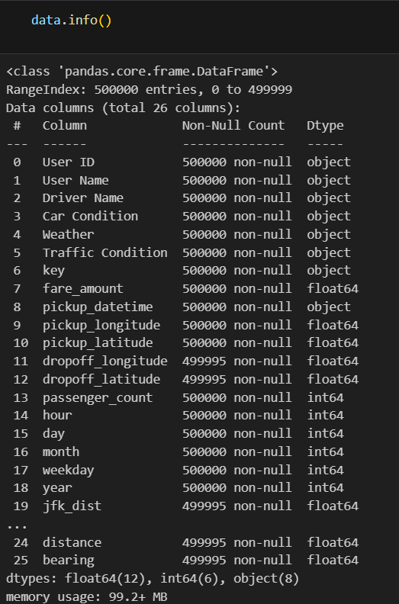
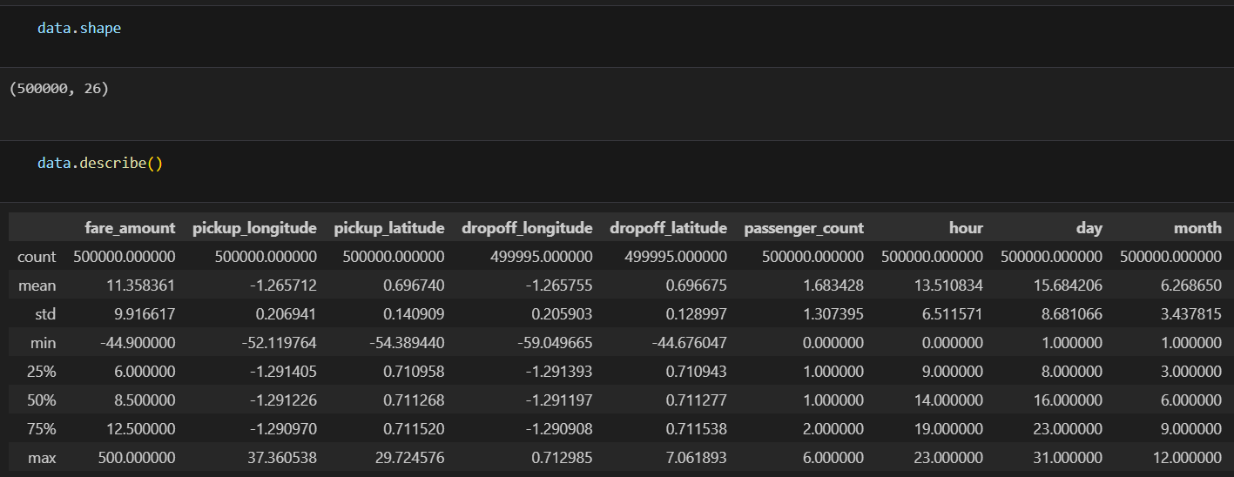
EDA

Slide 10
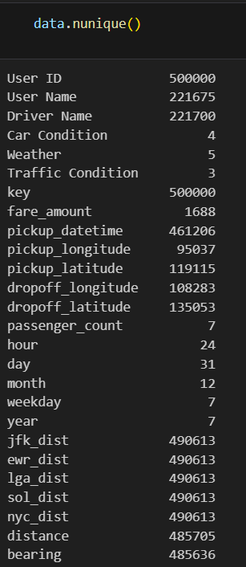
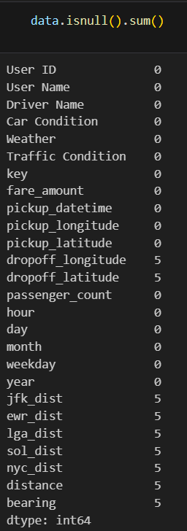
EDA

Slide 11
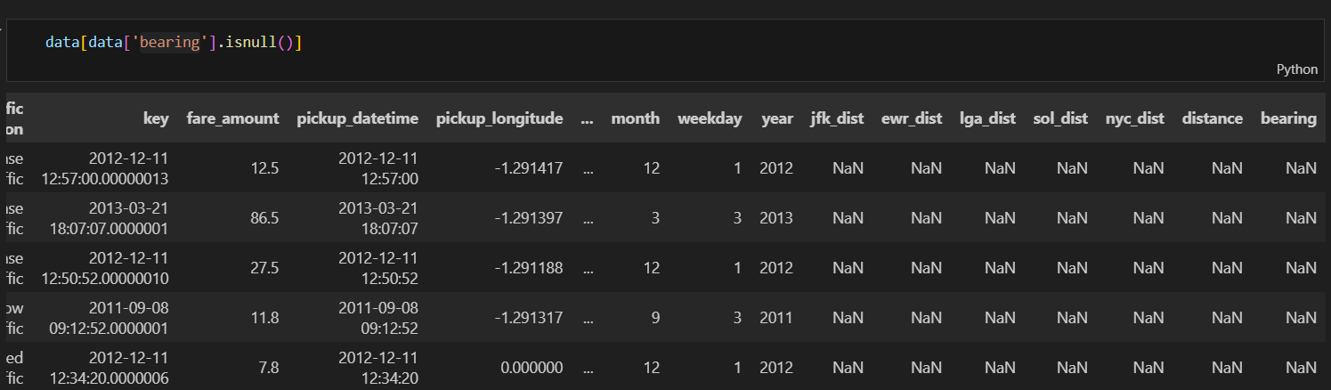
Checking for nulls

Slide 12
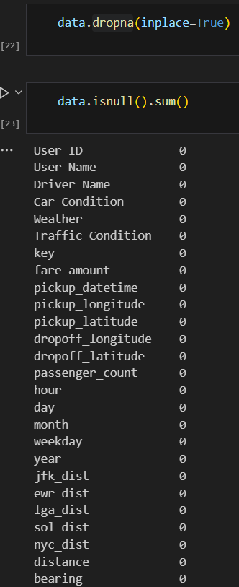
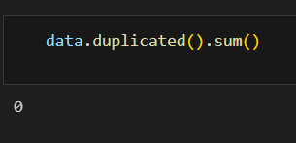
Data Cleaning

Slide 13
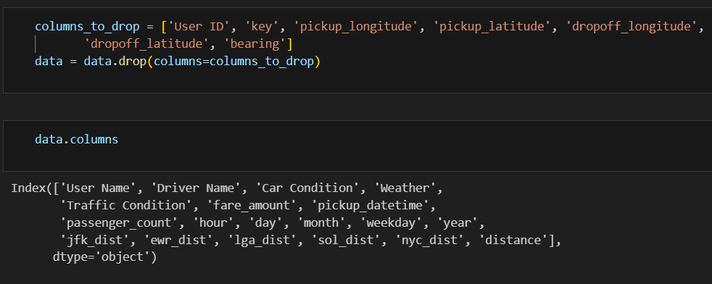
Removing Unwanted Columns

Slide 14
Removing False Values

Slide 15
After Removing False Values

Slide 16
03
Gana

Slide 17
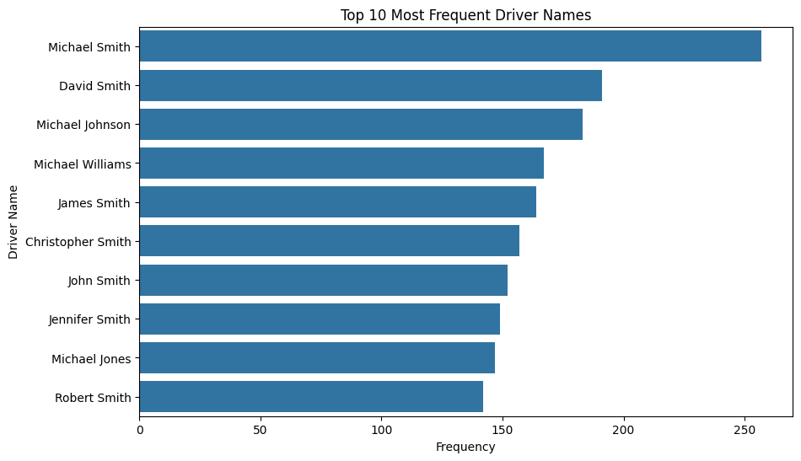
Driver Performance
The corresponding chart displays the frequency of trips completed by each driver, allowing us to evaluate the performance and popularity of these drivers within the service.
As shown, Michael Smith leads with over 250 trips, exemplifying reliability and customer satisfaction. David Smith follows with nearly 200 trips, while drivers like Michael Johnson, Michael Williams, and James Smith each complete 100-150 trips, showcasing consistent excellence.
These top performers significantly enhance company reputation and service quality.

Slide 18
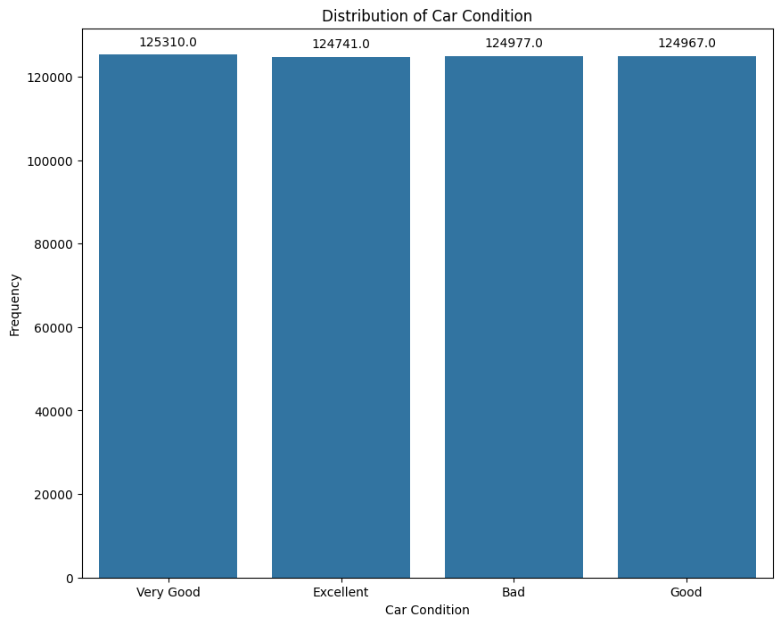
About Car Conditions
This bar chart shows the distribution of car conditions in the dataset, with each category ("Very Good," "Excellent," "Bad," and "Good") having around 125,000 trips. The uniform distribution suggests consistent application of car condition ratings. However, the significant number of trips with "Bad" conditions indicates a potential area for improvement in vehicle maintenance to enhance overall service quality and customer satisfaction

Slide 19
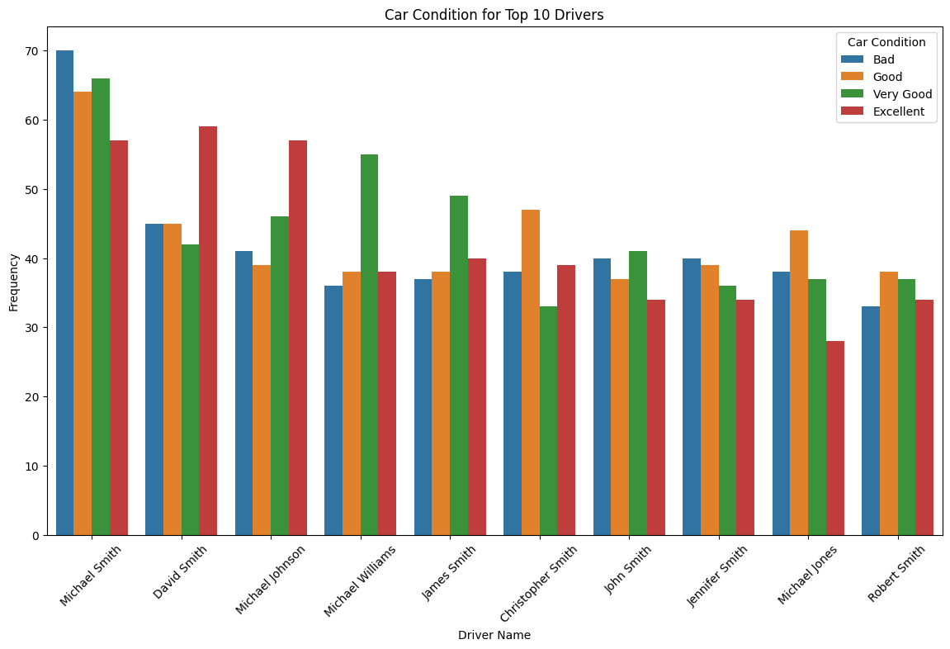
About Car Conditions
As shown, Each driver has a mix of car conditions ("Bad," "Good," "Very Good," "Excellent"), with most trips occurring in "Excellent" and "Good" conditions. This indicates that these top drivers often use well-maintained vehicles, contributing to consistent service quality.

Slide 20
04
Nehad

Slide 21
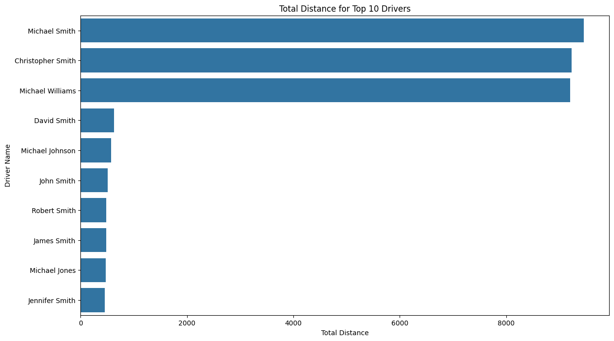
The Drivers with most total distance

Slide 22
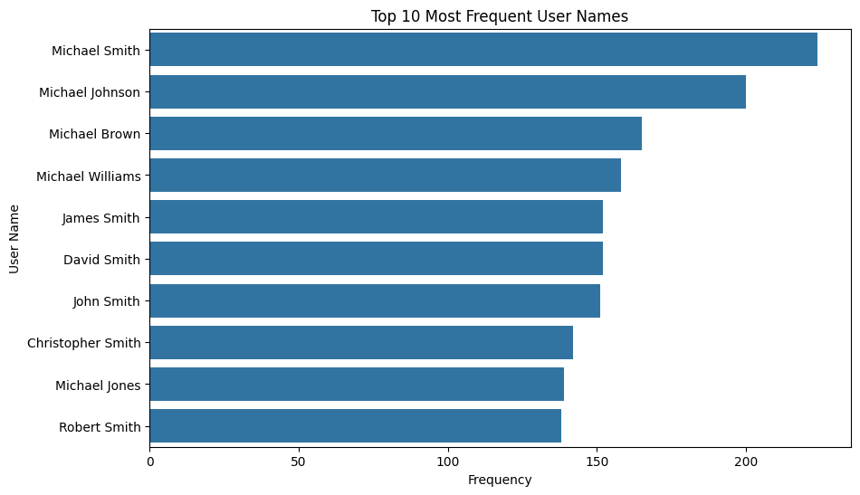
Most Frequent Users

Slide 23
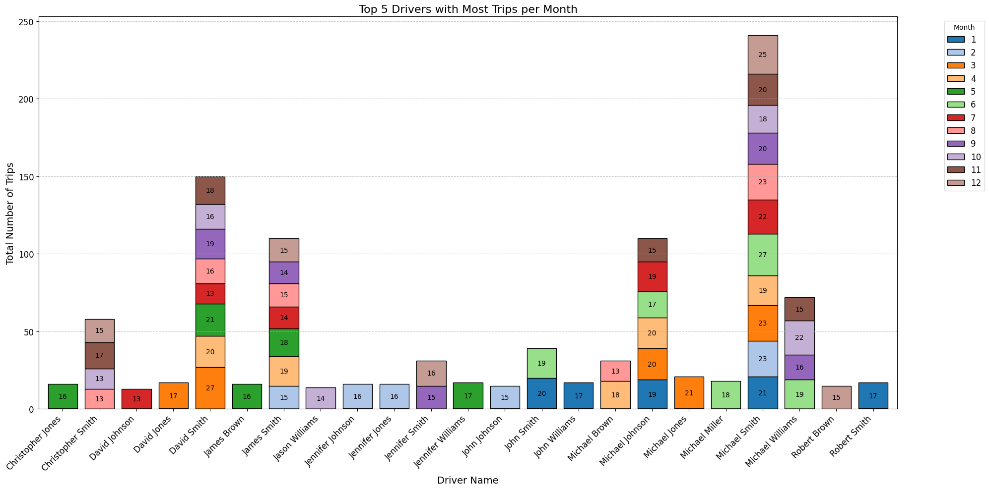
Drivers with most trips per mont

Slide 24
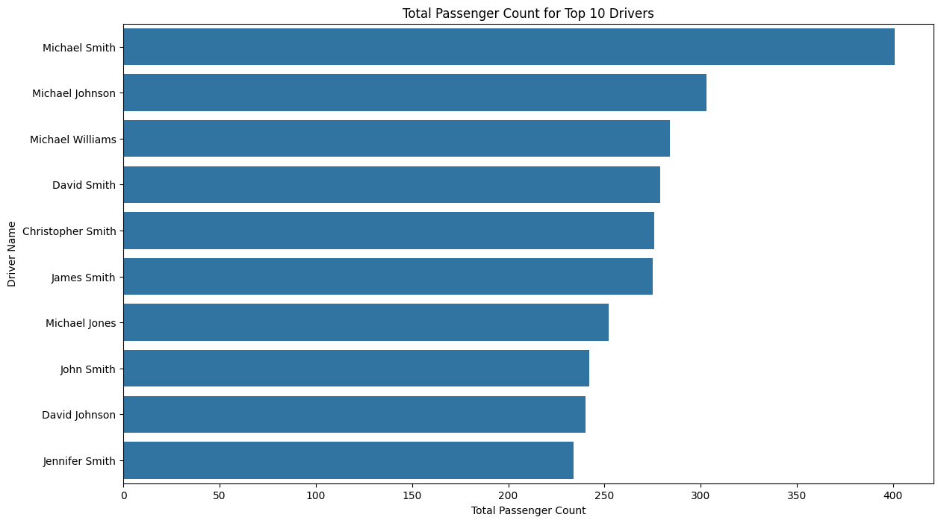
Passenger Count and The Drivers

Slide 25
05
Thamer

Slide 26
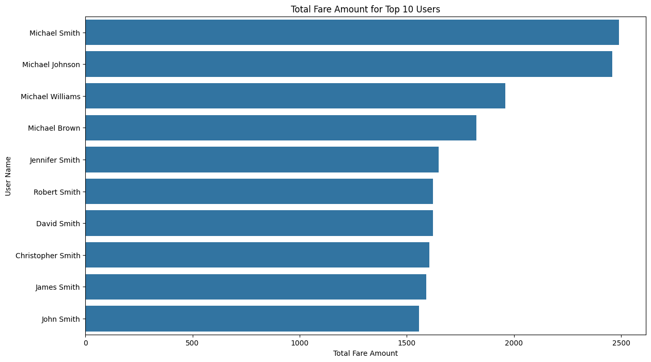
Total Fare Amount and The Users

Slide 27
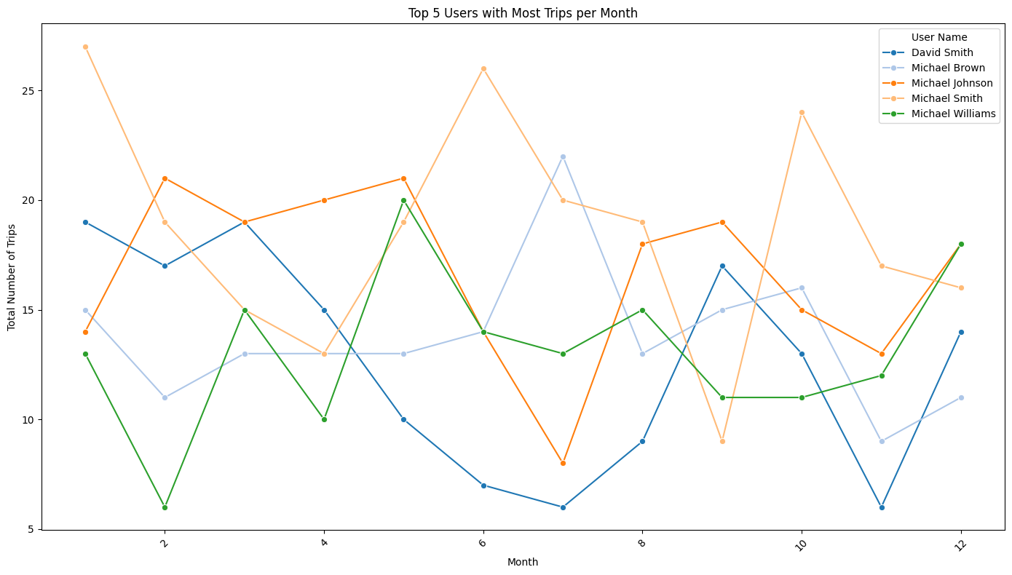
Line Chart for The Users and Trips per mont

Slide 28
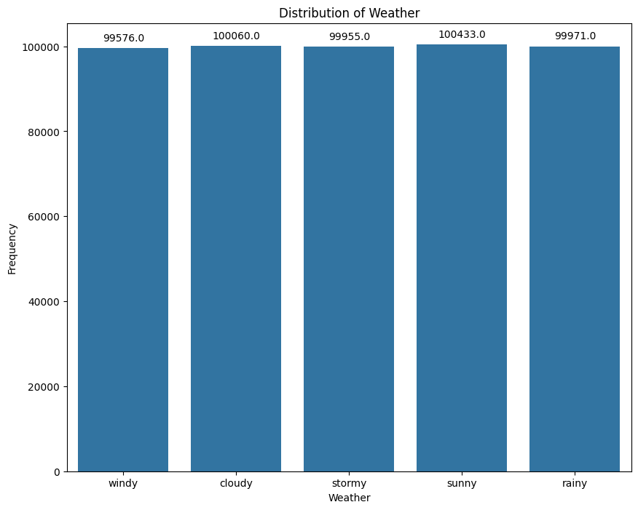
Bar-plot for Weather

Slide 29
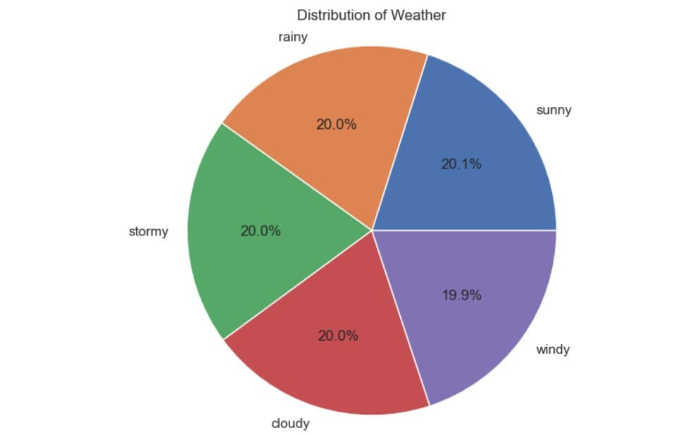
Pie-Chart for The Weather

Slide 30
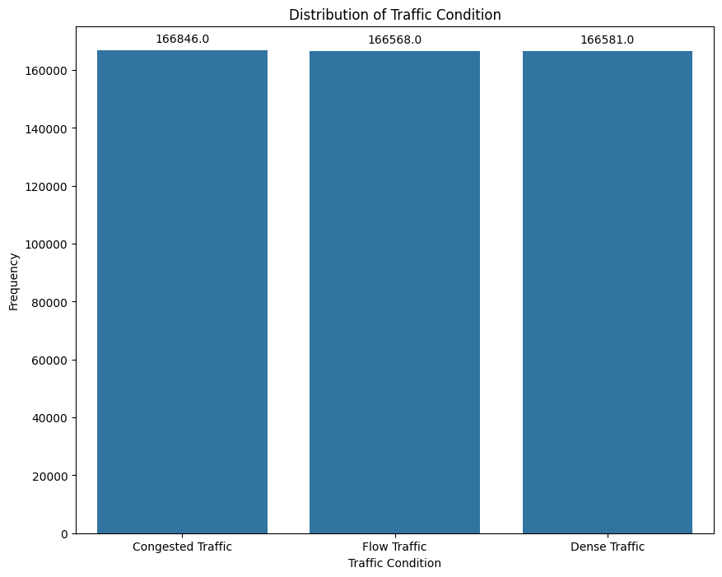
Bar-plot fro Traffic Condition

Slide 31
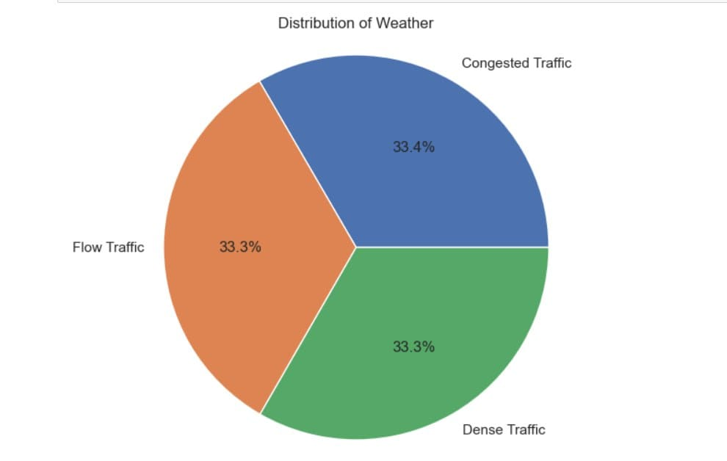
Pie-Chart for the Weather

Slide 32
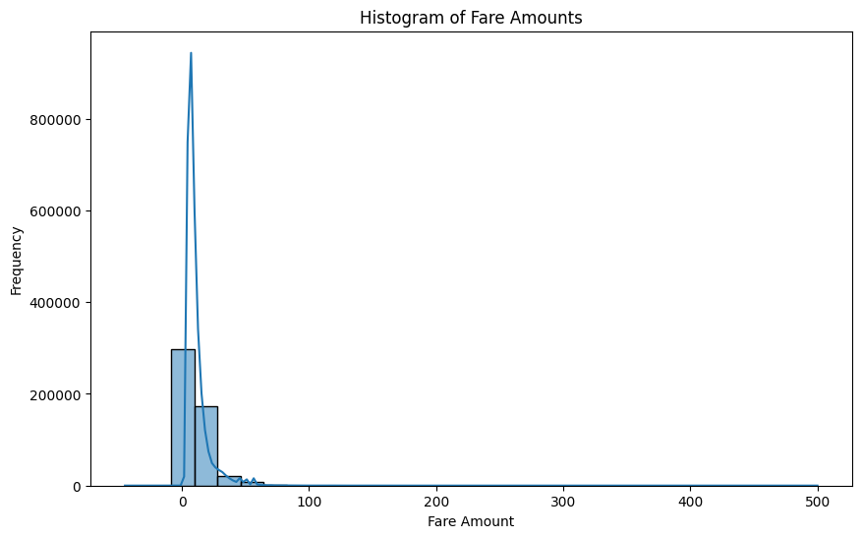
Hist-Plot for Fare Amounts

Slide 33
06
Hashem

Slide 34
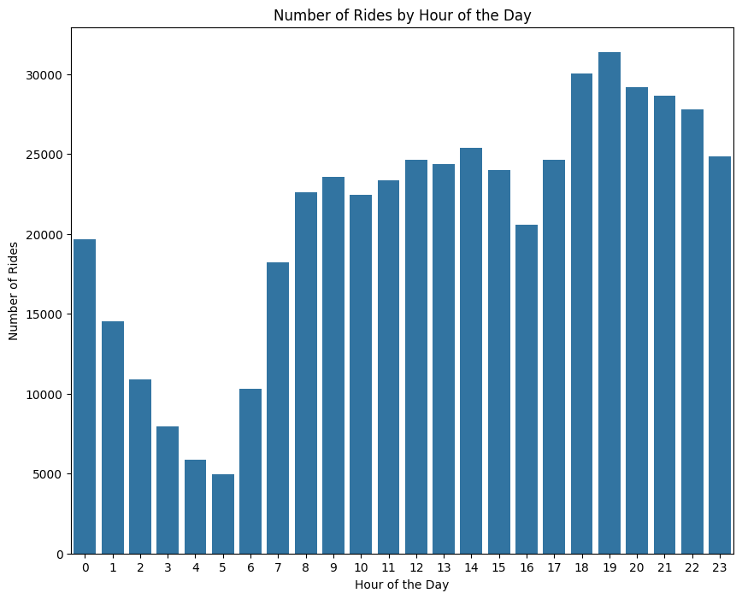
Number of Rides by Hour

Slide 35
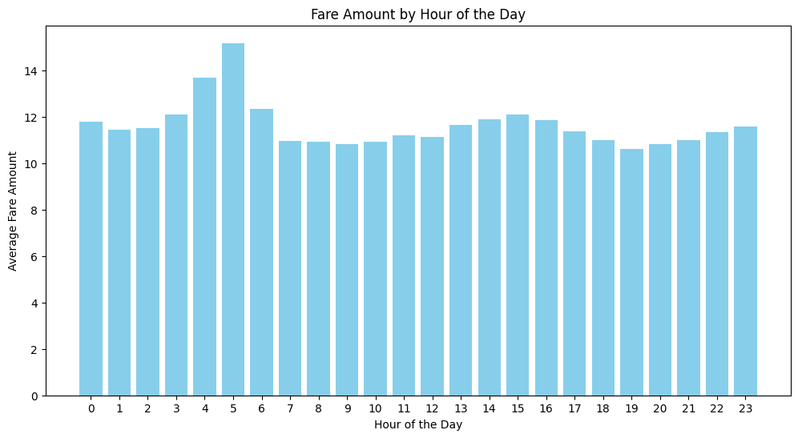
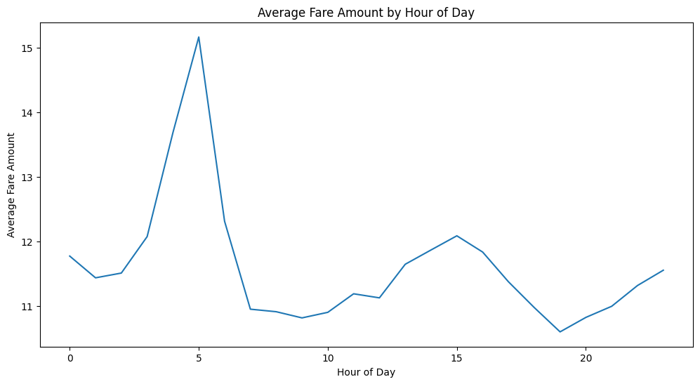
Average Fare Amount by Hour

Slide 36
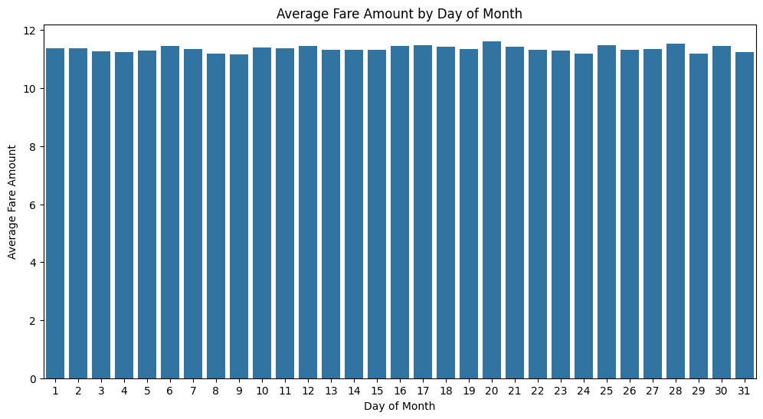
Average Fare Amount and the Days

Slide 37
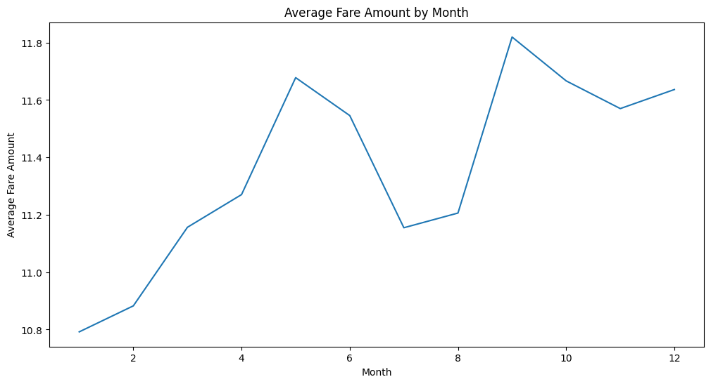
Average Fare Amount and Months

Slide 38
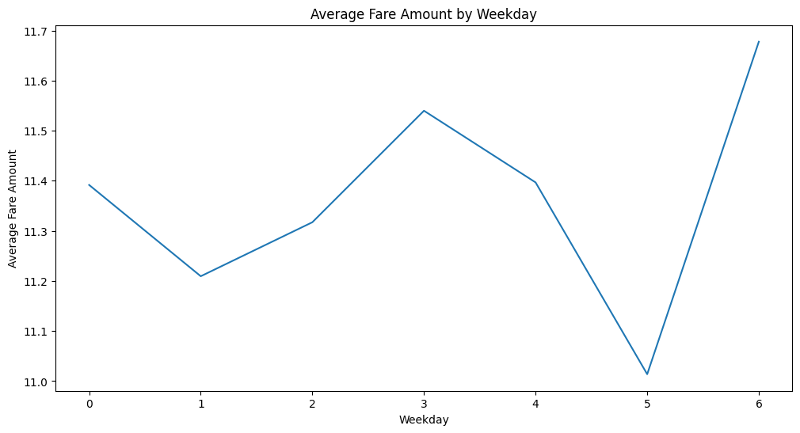
Average Fare Amount and Weekday

Slide 39
07
Laith

Slide 40
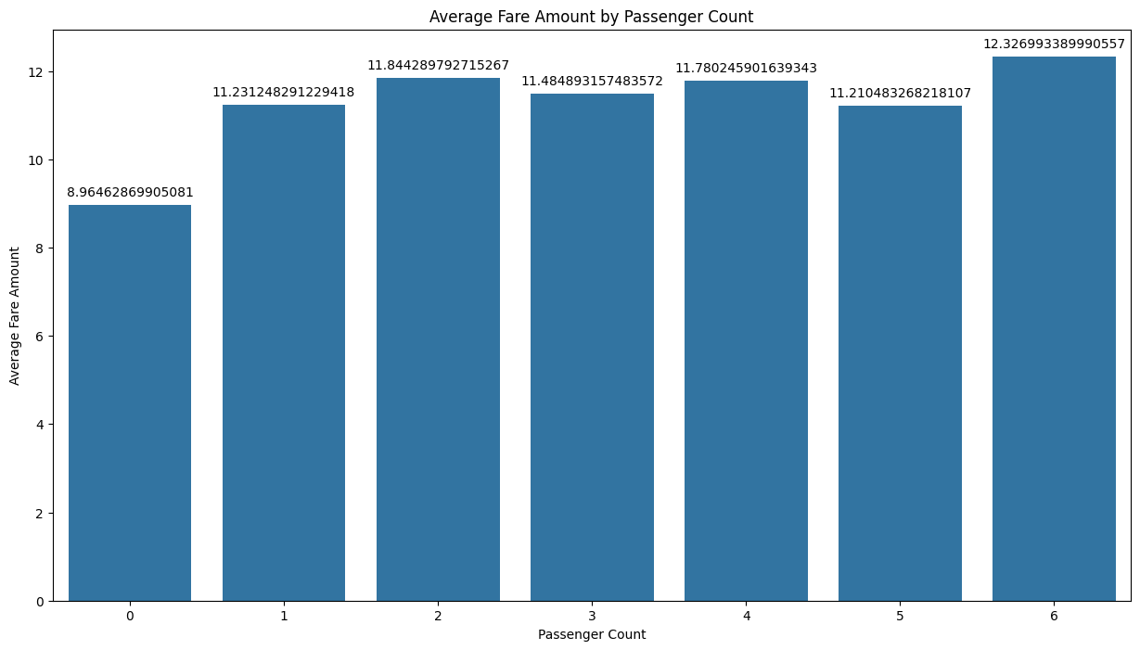
Average Fare Amount and Passenger Count

Slide 41
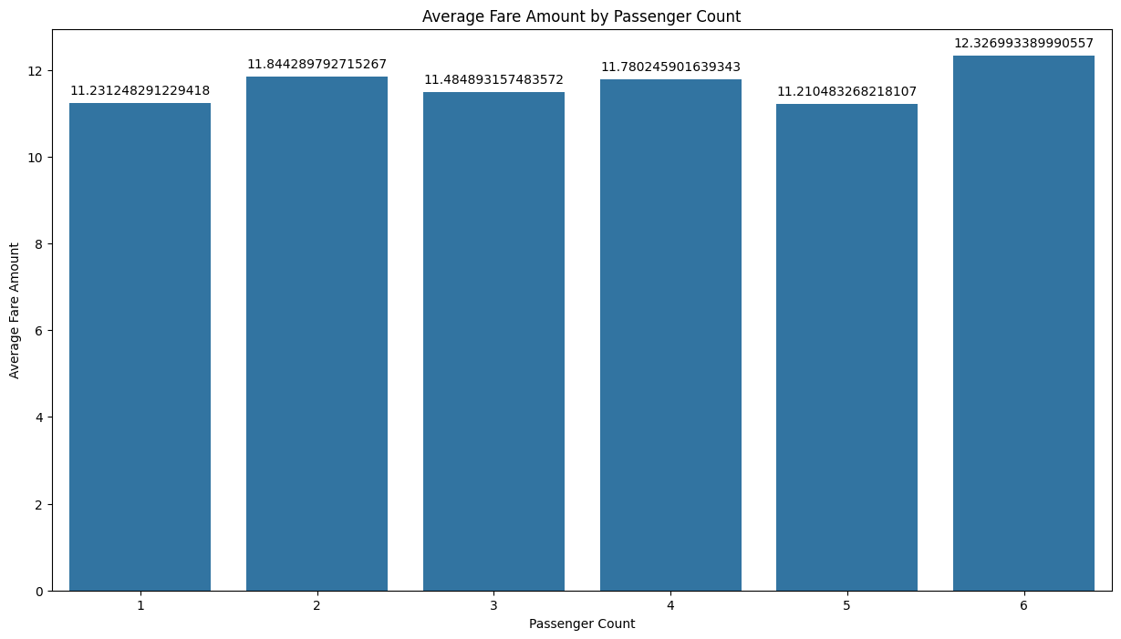
Average Fare Amount and Passenger Count

Slide 42
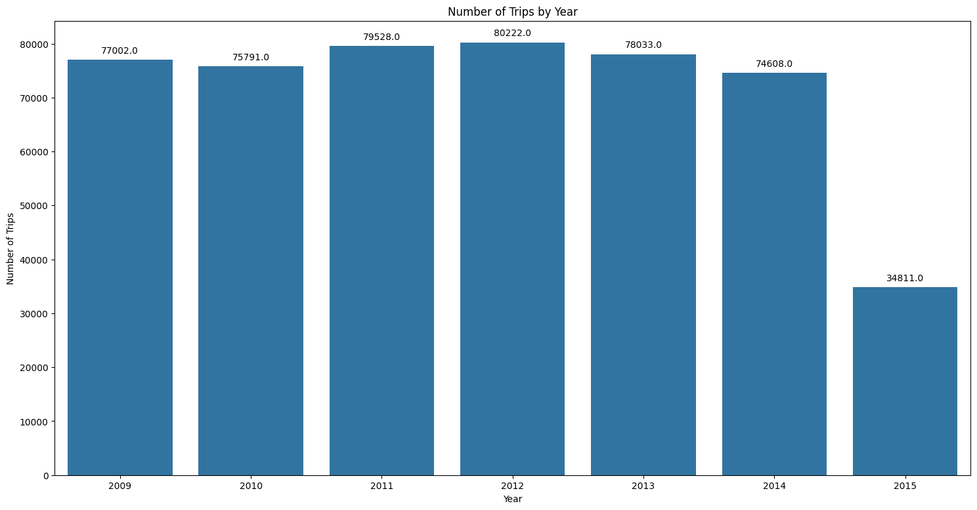
Number of Trips by Year

Slide 43
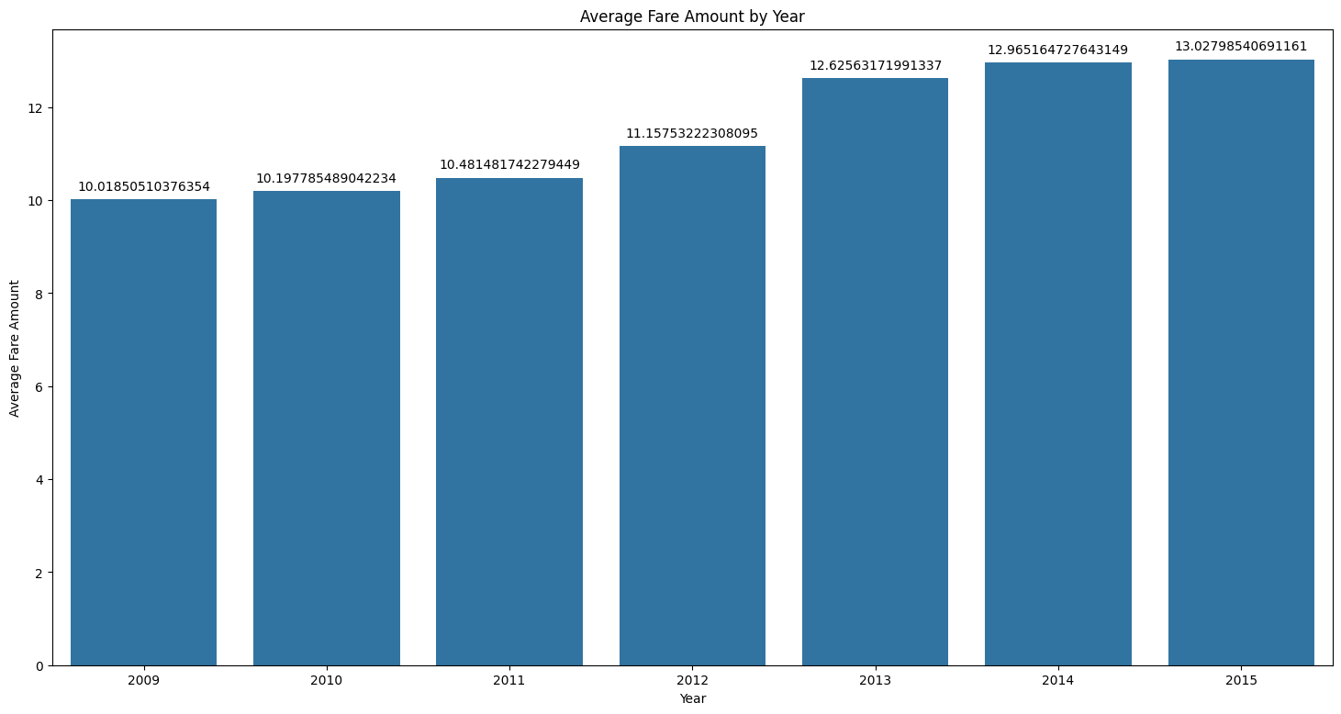
Average Fare Amount by year

Slide 44
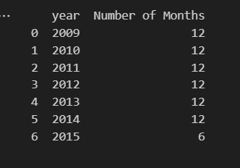
Number of months for each year

Slide 45
08
Mohammad

Slide 46
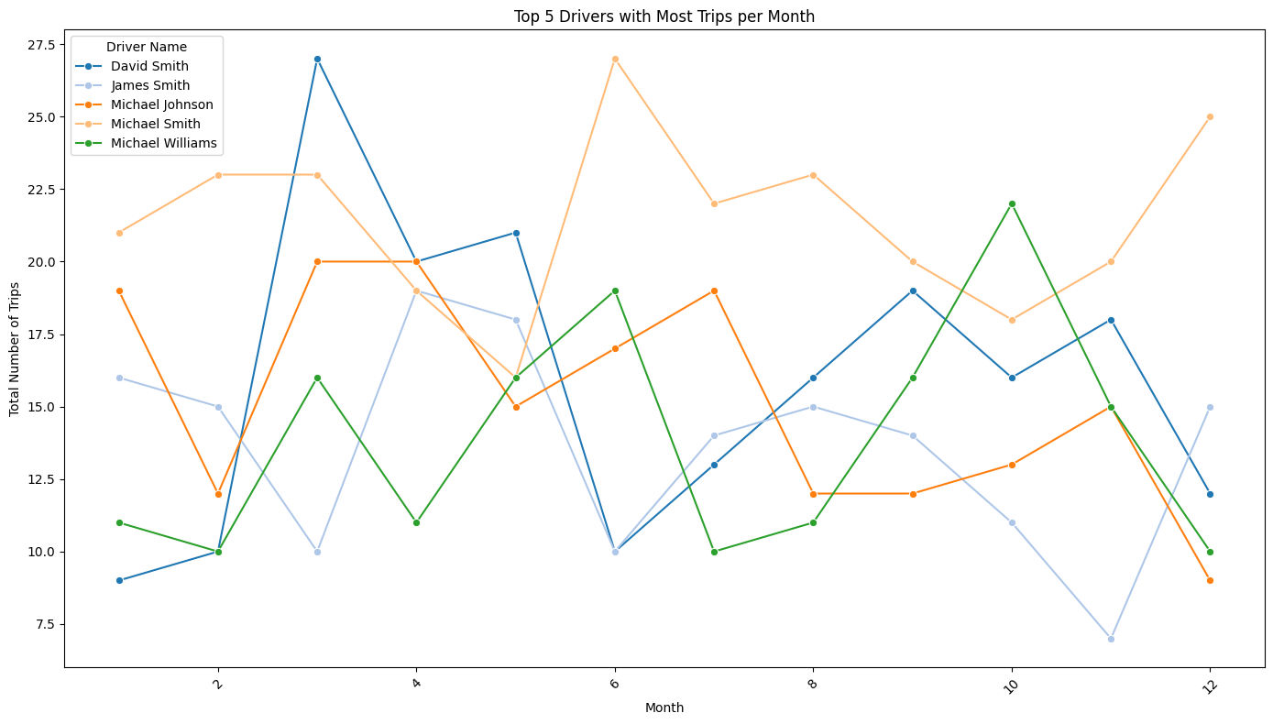
Driver with most trips per month

Slide 47
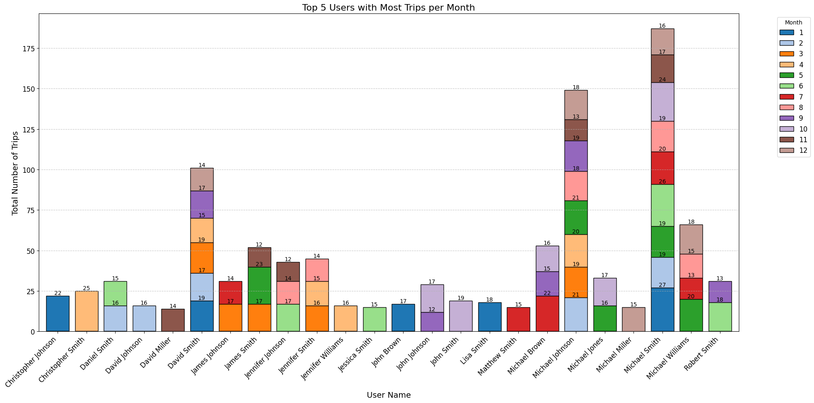
User with most trips per month

Slide 48
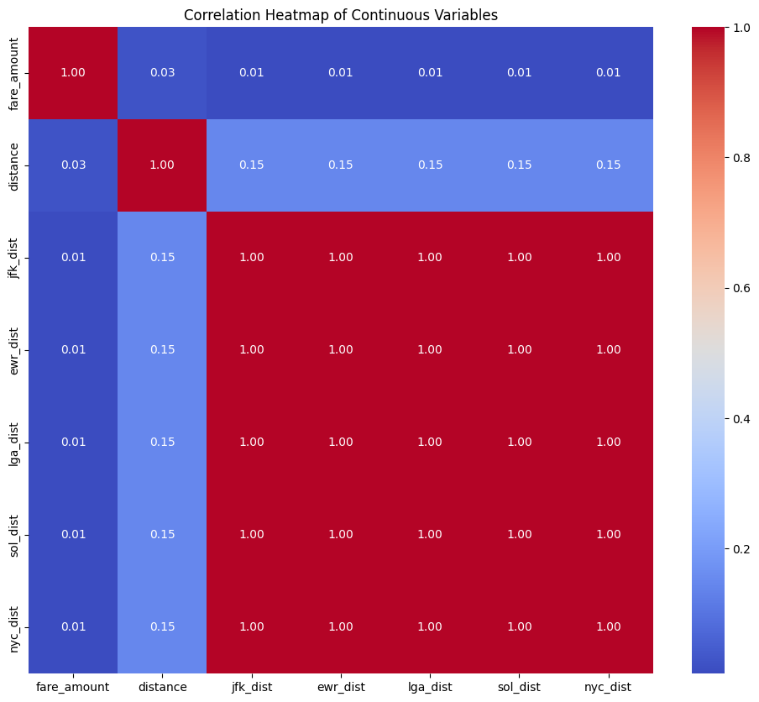
Heat-Map

Slide 49
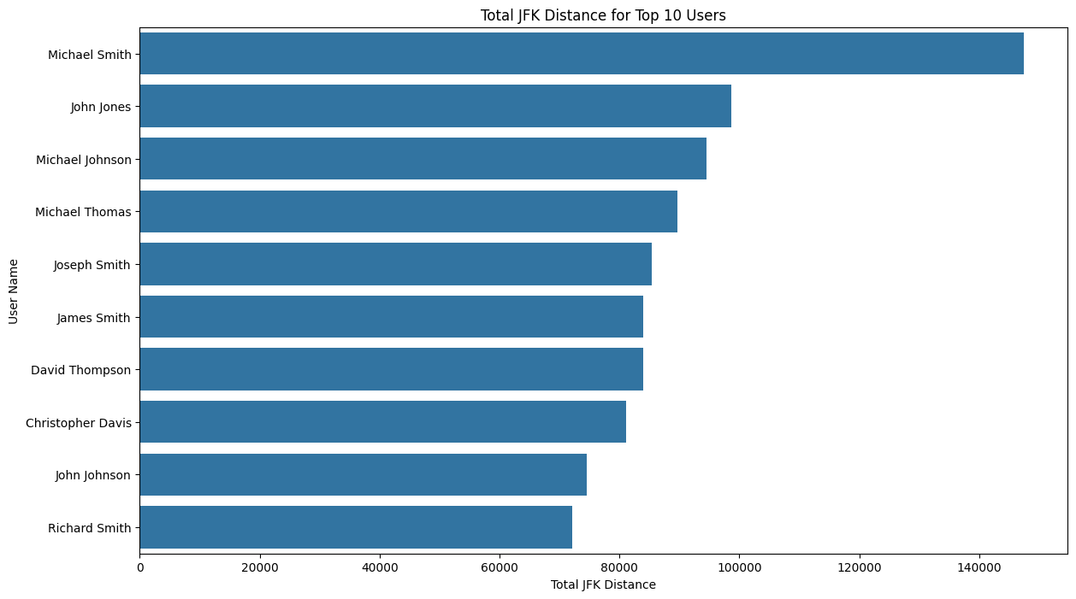
User and Total JFK Distance

Slide 50

User and Total EWR Distance

Slide 51
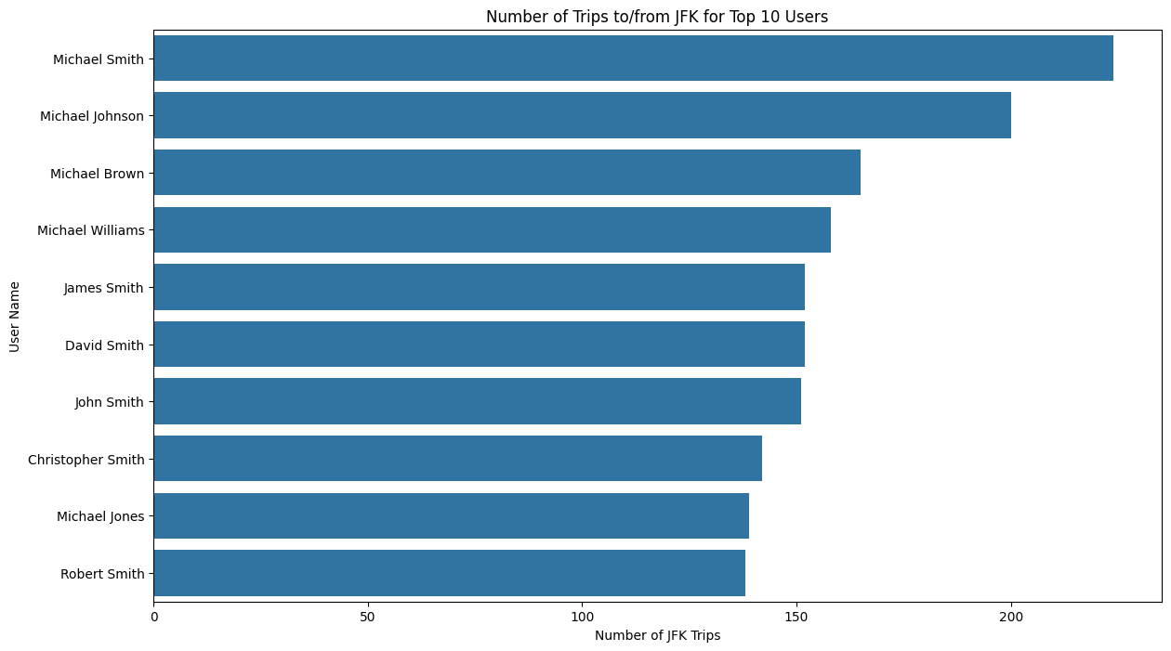
Number of trips for the Users to/from JFK

Slide 52

Number of trips for the Users to/from EWR

Slide 53
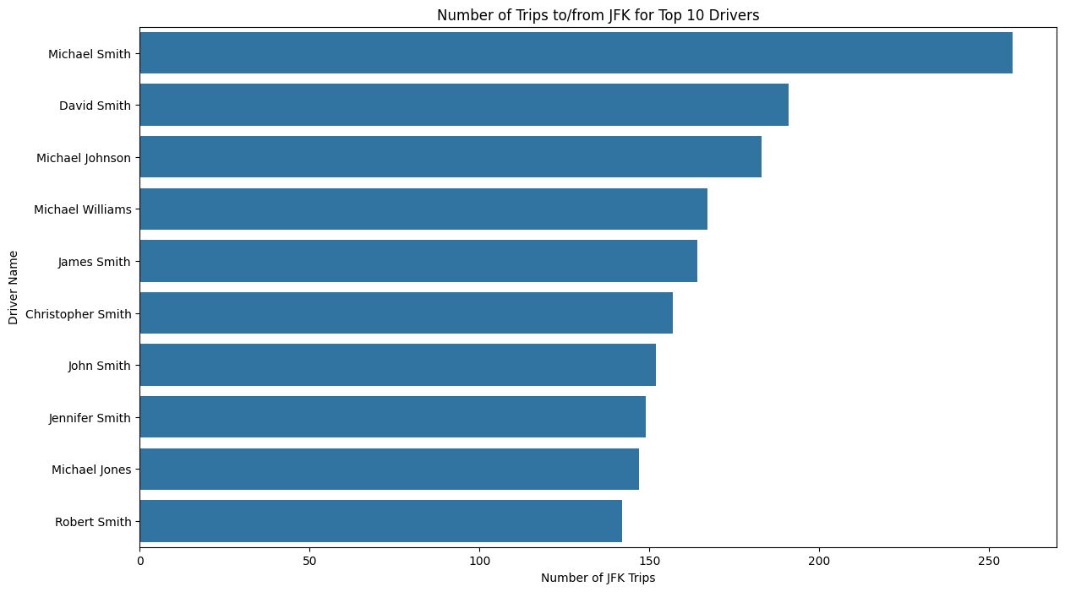
Number of trips for the Drivers to/from JFK

